Slide 1
Introduction to Algorithms
Levon Prazyan

Slide 2
Course Overview
Introduction
Sorting and Searching
Arrays and Lists
Stacks and Queues, Double Ended Queue
Heaps
Trees
Hash Tables
Dynamic Programming
Greedy Algorithms
Graph Algorithms
Network Flow
NP-Completeness

Slide 3
Bubble Sort Illustration

Slide 4
Bubble Sort

Slide 5
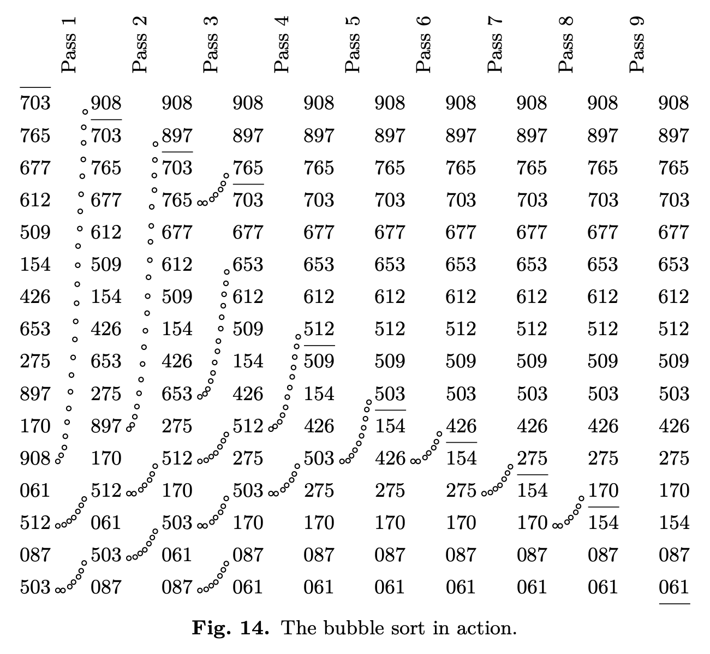
Bubble Sort
BubbleSort(A):
for i = 1 to A.length:
swapped = false
for j = 1 to A.length-i
if A[j] > A[j+1]
swap(A[j], A[j+1])
swapped = true
if swapped == false:
break // exit early
Notes:
Outer loop runs for A.length elements
Inner loop compares adjacent elements and swaps them if they are in the wrong order.
Optimization: If no swaps occur in a full pass, the array is already sorted, and we can break early.

Slide 6

Bubble Sort: Correctness
BubbleSort(A):
for i = 1 to A.length:
swapped = false
for j = 1 to A.length-i
if A[j] > A[j+1]
swap(A[j], A[j+1])
swapped = true
if swapped == false:
break // exit early
Invariant: At the end of the $i$-th outer loop iteration, the last $i$ elements of the array are in their correct sorted positions.
Notes:
Bubble Sort works by repeatedly swapping adjacent elements if they are in the wrong order. After each full pass, the largest unsorted element "bubbles up" to its correct position.

Slide 7
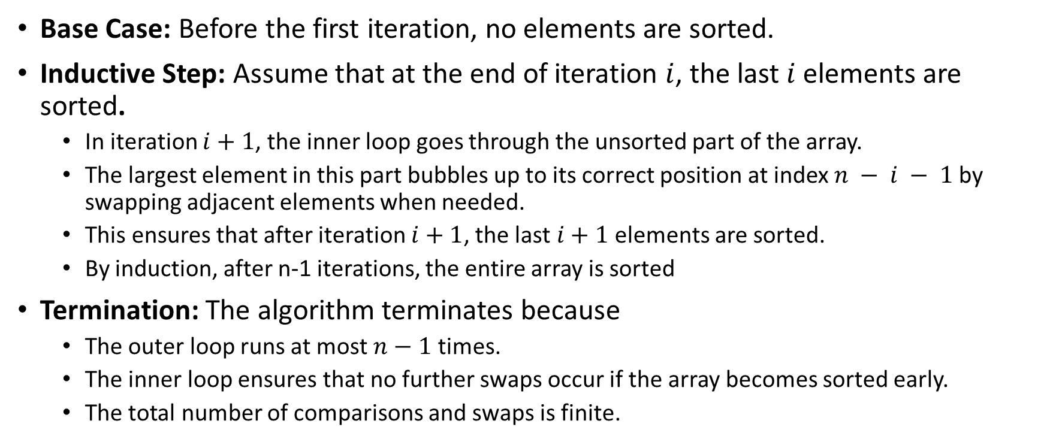
Bubble Sort: Correctness: Proof by Induction
Base Case: Before the first iteration, no elements are sorted.
Inductive Step: Assume that at the end of iteration $i$, the last $i$ elements are sorted.
In iteration $i+1$, the inner loop goes through the unsorted part of the array.
The largest element in this part bubbles up to its correct position at index $n − i − 1$ by swapping adjacent elements when needed.
This ensures that after iteration $i+1$, the last $i+1$ elements are sorted.
By induction, after n-1 iterations, the entire array is sorted
Termination: The algorithm terminates because
The outer loop runs at most $n−1$ times.
The inner loop ensures that no further swaps occur if the array becomes sorted early.
The total number of comparisons and swaps is finite.
Notes:
Bubble Sort works by repeatedly swapping adjacent elements if they are in the wrong order. After each full pass, the largest unsorted element "bubbles up" to its correct position.

Slide 8
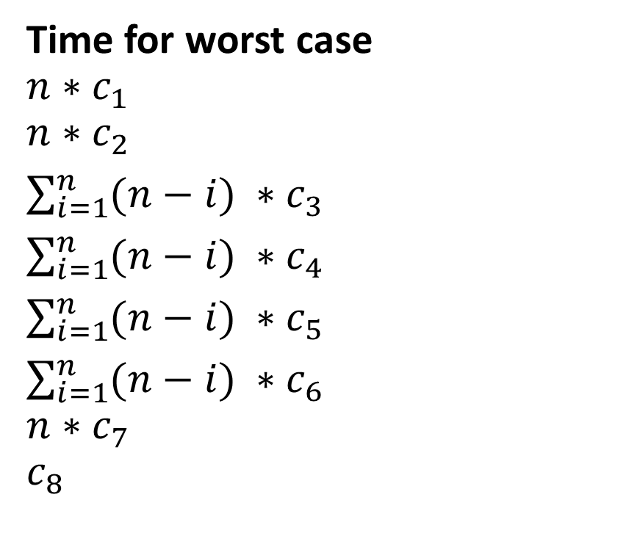
Bubble Sort: Complexity (1)
BubbleSort(A):
for i = 1 to A.length:
swapped = false
for j = 1 to A.length-i
if A[j] > A[j+1]
swap(A[j], A[j+1])
swapped = true
if swapped == false:
break // exit early
Time for worst case
$$n∗c_{1}$$
$$n∗c_{2}$$
$\sum_{i=1}^{n}{(n−i)} ∗c_{3}$
$\sum_{i=1}^{n}{(n−i)} ∗c_{4}$
$\sum_{i=1}^{n}{(n−i)} ∗c_{5}$
$\sum_{i=1}^{n}{(n−i)} ∗c_{6}$
$$n∗c_{7}$$
$$c_{8}$$
Notes:
Bubble Sort works by repeatedly swapping adjacent elements if they are in the wrong order. After each full pass, the largest unsorted element "bubbles up" to its correct position.

Slide 9

Bubble Sort: Complexity (2)
$$T\left(n\right)= n∗(c_{1}+c_{2}+c_{7})+(c_{3}+c_{4}+c_{5}+c_{6})∗\sum_{i=1}^{n}{\left(n−i\right)}+c_{8}$$
$T\left(n\right)=an^{2}+bn+c$
Worst case: $T\left(n\right)=Θ\left(n^{2}\right)$
Best case: $T\left(n\right)=O\left(n\right)$
Notes:
Worst case: inverse sorted
Best case: sorted

Slide 10
Bubble Sort: Usage
When use
When avoid
Input is nearly sorted
Input size is small
Limited memory
Stability is important
Input size is large
Performance is a priority
General-purpose
Notes:
Bubble Sort is stable (it does not change the relative order of equal elements), which is useful in some applications.

Slide 11
Heap Sort
Heap, Priority Queue

Slide 12
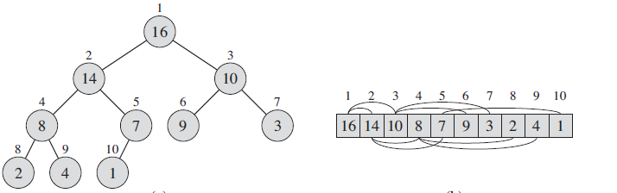
Heap
The (binary) heap data structure is an array object that we can view as a nearly complete binary tree.
Notes:
A:length, which (as usual) gives the number of elements in the array, and
A:heap-size, which represents how many elements in the heap are stored within
array A.

Slide 13
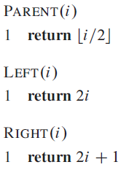

Heap Property
Max-heap property $A\left[Parent\left(i\right)\right]≥A(i)$
Min-heap property $A\left[Parent\left(i\right)\right]≤A(i)$
Notes:
the largest element in a max-heap is stored at the root,

Slide 14
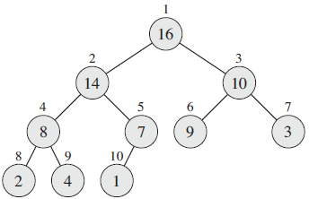
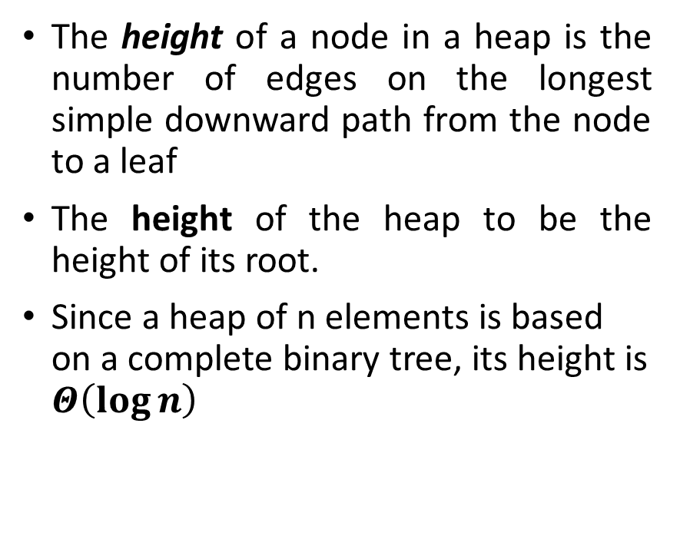
Heap Height
The height of a node in a heap is the number of edges on the longest simple downward path from the node to a leaf
The height of the heap to be the height of its root.
Since a heap of n elements is based on a complete binary tree, its height is $Θ\left(\log{n}\right)$

Slide 15
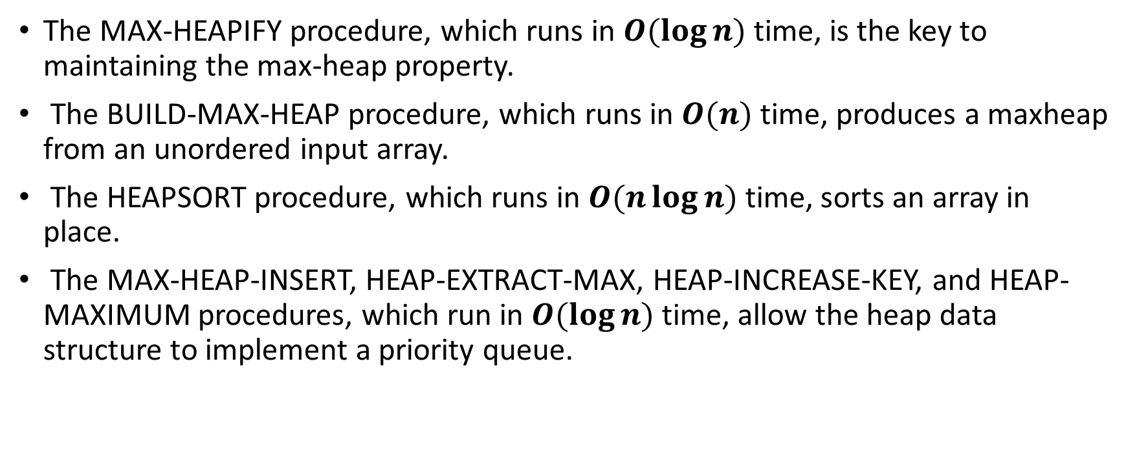
Heap: Operations
The MAX-HEAPIFY procedure, which runs in $O(\log{n})$ time, is the key to maintaining the max-heap property.
The BUILD-MAX-HEAP procedure, which runs in $O(n)$ time, produces a maxheap from an unordered input array.
The HEAPSORT procedure, which runs in $O(n\log{n})$ time, sorts an array in place.
The MAX-HEAP-INSERT, HEAP-EXTRACT-MAX, HEAP-INCREASE-KEY, and HEAP-MAXIMUM procedures, which run in $O(\log{n})$ time, allow the heap data structure to implement a priority queue.

Slide 16
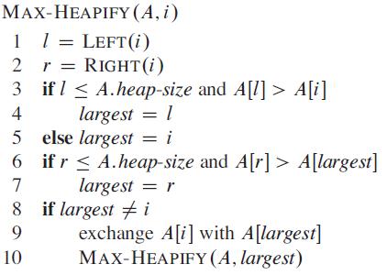
Heap Sort: Max-Heapify (1)
MAX-HEAPIFY assumes that the binary trees rooted at LEFT(i) and RIGHT(i) are max-heaps, but that A(i) might be smaller than its children.

Slide 17
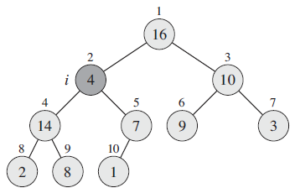
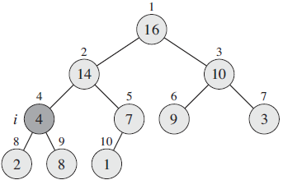
Heap Sort: Max-Heapify (2)

Slide 18
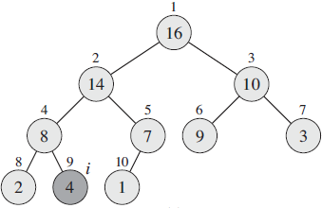
Heap Sort: Max-Heapify (3)

Slide 19
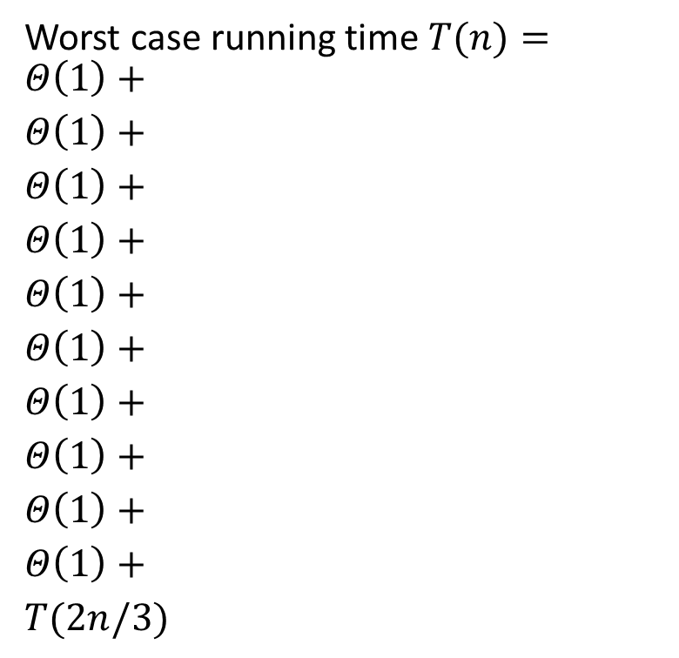
Heap Sort: Max-Heapify Running Time (1)
Worst case running time $T(n)=$
$$Θ\left(1\right)+$$
$$Θ\left(1\right)+$$
$$Θ\left(1\right)+$$
$$Θ\left(1\right)+$$
$$Θ\left(1\right)+$$
$$Θ\left(1\right)+$$
$$Θ\left(1\right)+$$
$$Θ\left(1\right)+$$
$$Θ\left(1\right)+$$
$$Θ\left(1\right)+$$
$$T(2n/3)$$

Slide 20

Heap Sort: Max-Heapify Running Time (2)
$$T(n)=T(2n/3)+ Θ\left(1\right)$$
$$Θ\left(1\right)=Θ\left(n^{\log_{\frac{2}{3}}{1}}\right)$$
$$T\left(n\right)=Θ\left(n^{\log_{\frac{2}{3}}{1}}\log{n}\right)$$
Worst case: $T\left(n\right)=Θ\left(\log{n}\right)$
In general: $T\left(n\right)=O\left(\log{n}\right)$

Slide 21
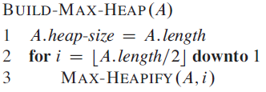
Heap Sort: Build-Max-Heap
The Build-Max-Heap produces a maxheap from an unordered input array

Slide 22
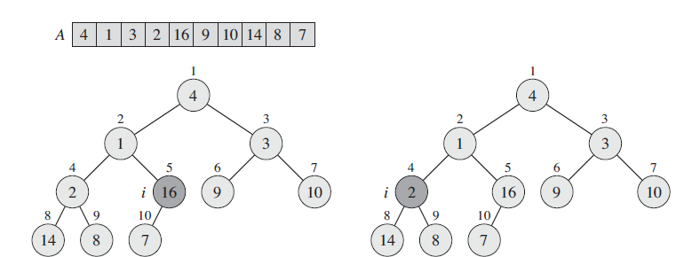
Heap Sort: Build-Max-Heap (2)

Slide 23
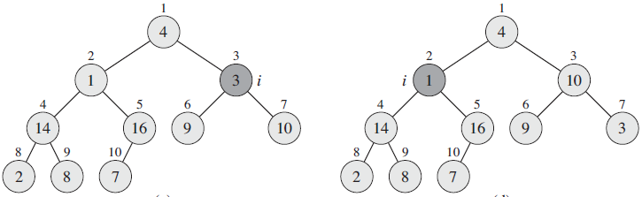
Heap Sort: Build-Max-Heap (3)

Slide 24
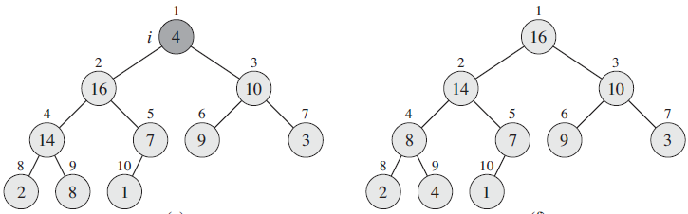
Heap Sort: Build-Max-Heap (4)

Slide 25
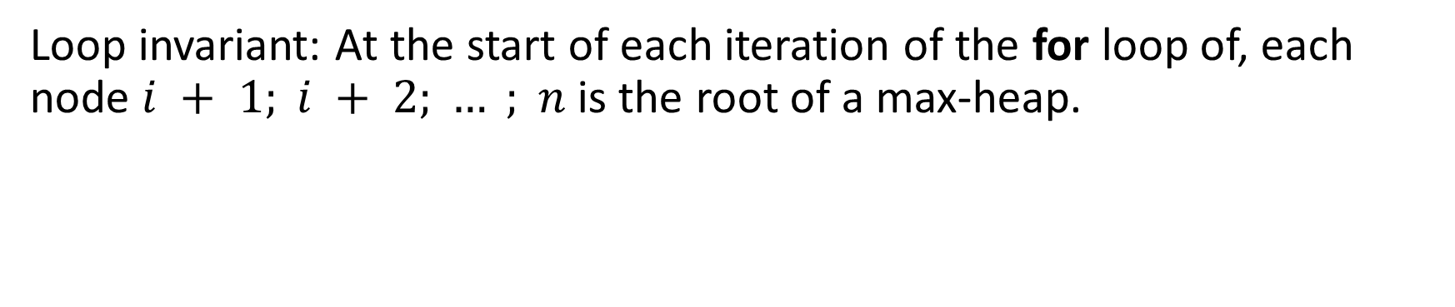
Heap Sort: Build-Max-Heap: Correctness (1)
Loop invariant: At the start of each iteration of the for loop of, each node $i + 1; i + 2; … ; n$ is the root of a max-heap.

Slide 26
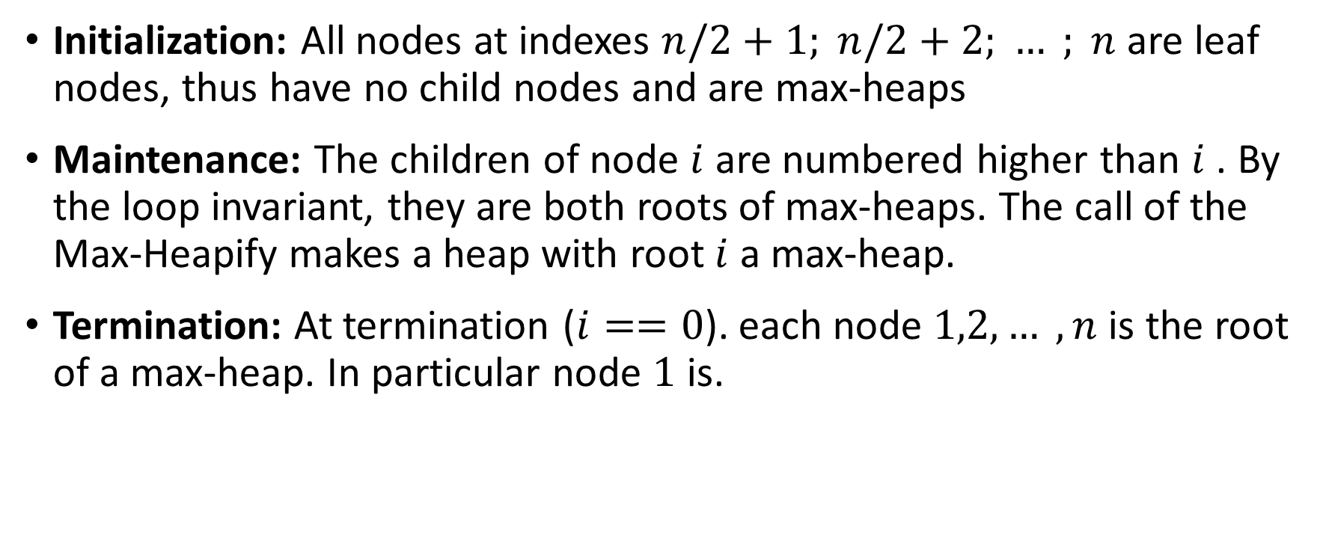
Heap Sort: Build-Max-Heap: Correctness (2)
Initialization: All nodes at indexes $n/2+1; n/2+2; … ; n$are leaf nodes, thus have no child nodes and are max-heaps
Maintenance: The children of node $i$ are numbered higher than $i$ . By the loop invariant, they are both roots of max-heaps. The call of the Max-Heapify makes a heap with root $i$ a max-heap.
Termination: At termination ($i==0$). each node $1,2, … , n$is the root of a max-heap. In particular node $1$ is.

Slide 27

Heap Sort: Build-Max-Heap: Running Time (1)
Worst case running time $T(n)=$
$$Θ\left(1\right)+$$
$Θ\left(n/2\right)$+
$$\sum_{i=1}^{\log{n}}{\frac{n∗i}{2^{i}}}$$

Slide 28

Heap Sort: Build-Max-Heap: Running Time (2)
$$T\left(n\right)=Θ\left(n\right)+\sum_{i=1}^{\log{n}}{\frac{n∗i}{2^{i}}}$$
$$\sum_{i=1}^{\log{n}}{\frac{i}{2^{i}}}=2−\frac{\log{n}+2}{ n}<2$$
$$T\left(n\right)=O\left(n\right)$$

Slide 29
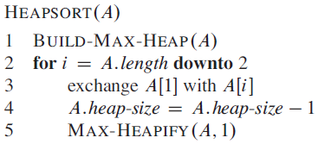
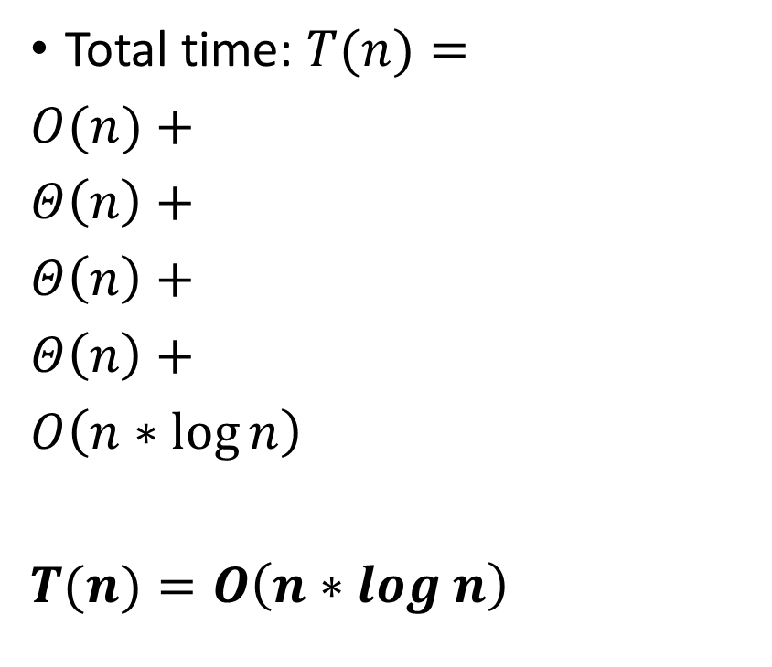
Heap Sort
Total time: $T(n)=$
$O(n)+$
$Θ\left(n\right)+$
$Θ\left(n\right)+$
$Θ\left(n\right)+$
$O\left(n∗\log{n}\right)$
$T(n)=O\left(n∗\log{n}\right)$

Slide 30
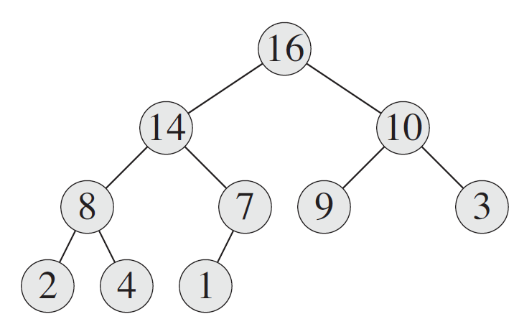
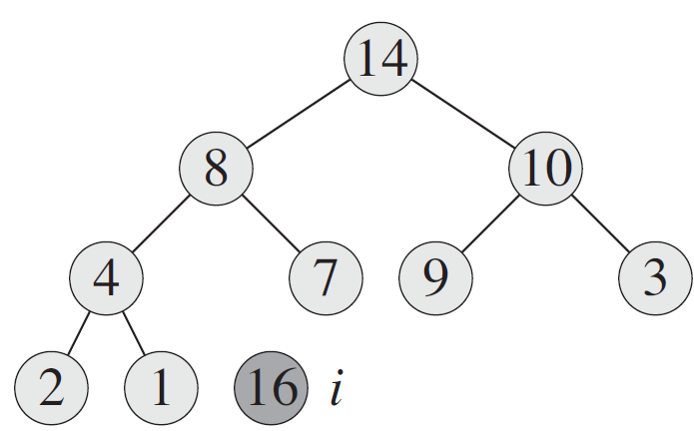
Heap Sort: Example (1)

Slide 31
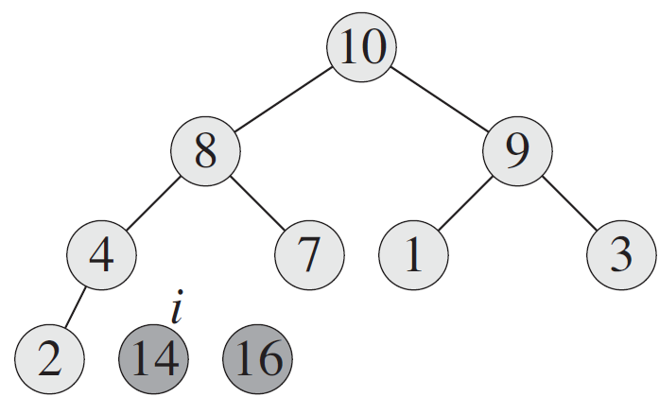
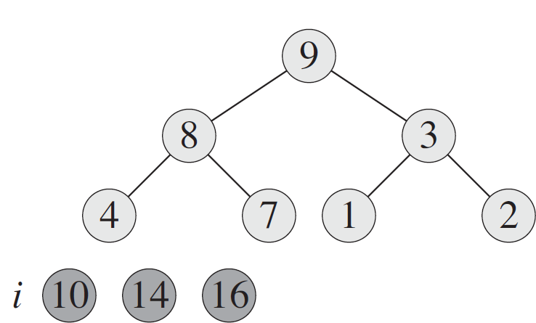
Heap Sort: Example (2)

Slide 32
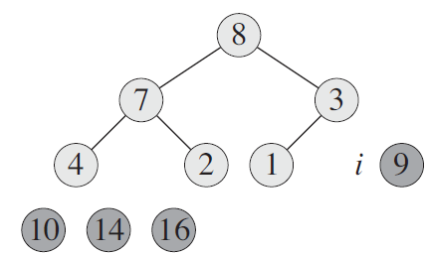
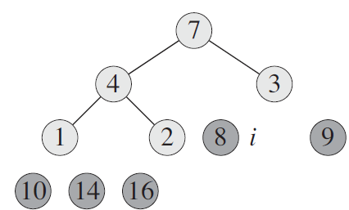
Heap Sort: Example (3)

Slide 33
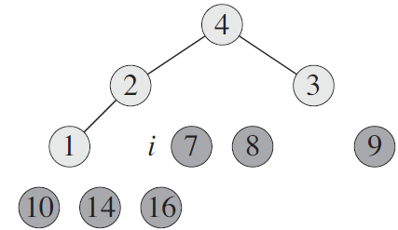
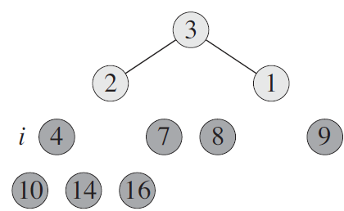
Heap Sort: Example (4)

Slide 34
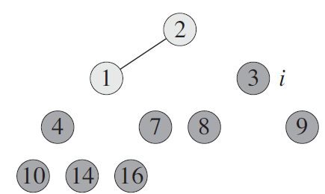
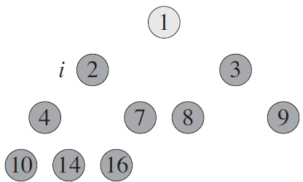

Heap Sort: Example (4)

Slide 35
Priority Queue (1)
A priority queue is a data structure for maintaining a set S of elements, each with an associated value called a key.
Insert
Maximum
Extract-Max
Increase-Key

Slide 36
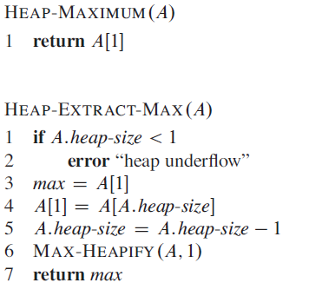

Priority Queue (2)
Total time: $Θ\left(1\right)$
Total time: $O\left(\log{n}\right)$

Slide 37
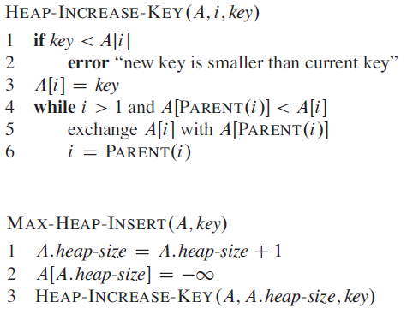

Priority Queue (3)
Total time: $O\left(\log{n}\right)$
Total time: $O\left(\log{n}\right)$

Slide 38
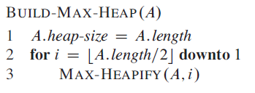
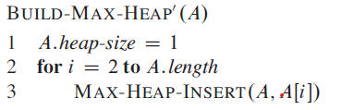
Build Max Heap
Notes:
BUILD-MAX-HEAP’ requires O(n*logn) time.

Slide 39
Quick Sort
QuickSort, RandomizedQuickSort

Slide 40
Quicksort
Worst-case running time: $Θ\left(n^{2}\right)$
Worst-case running time: 𝛩(𝑛^2 )
Average-case running time: $Θ\left(n\log{n}\right)$
Average-case running time: 𝛩(𝑛 log⁡𝑛 )
Notes:
Constant factor of average case is small
Sort in place

Slide 41
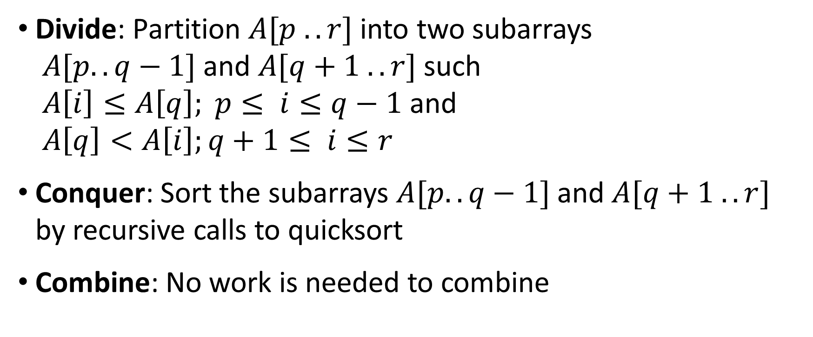
Quicksort: Devide-and-Conquer
Divide: Partition $A[p .. r]$into two subarrays $A[p..q−1]$and $A[q+1 .. r]$such $A\left[i\right]≤A\left[q\right]; p≤ i≤q−1$ and $A\left[q\right]<A\left[i\right];q+1≤ i≤r$
Conquer: Sort the subarrays $A[p..q−1]$and $A[q+1 .. r]$ by recursive calls to quicksort
Combine: No work is needed to combine

Slide 42
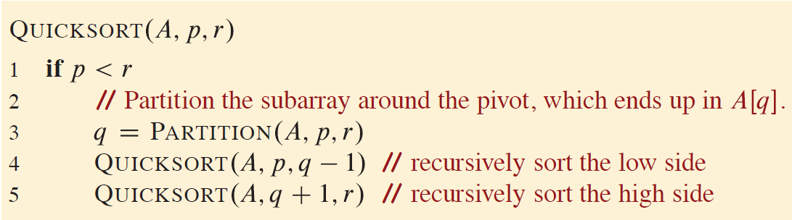
Quicksort Procedure

Slide 43
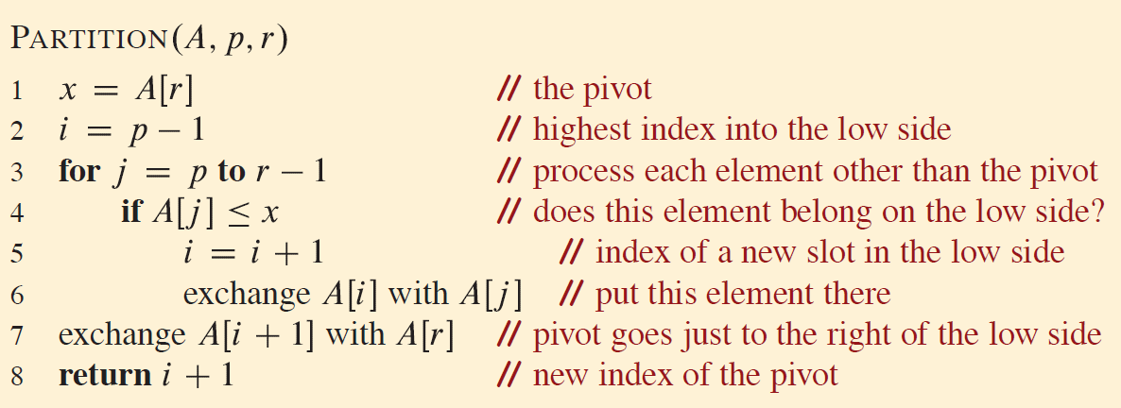
Quicksort: Partitioning procedure

Slide 44
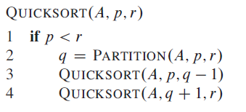
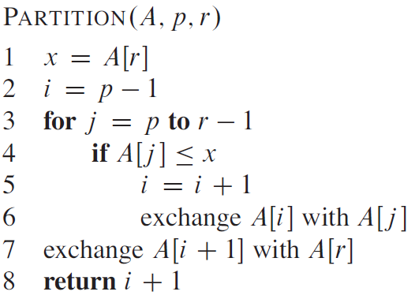
Quicksort and Partitioning

Slide 45
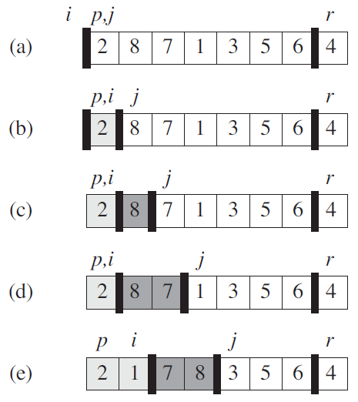
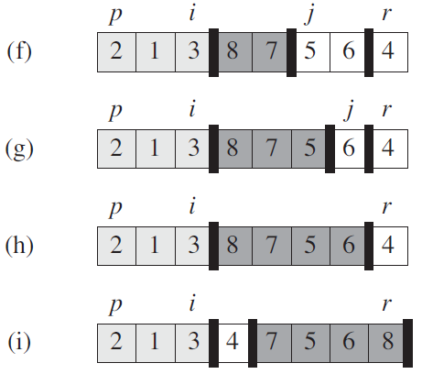
Quicksort: Partitioning

Slide 46

Quicksort: Partitioning: Correctness
Loop invariant:
$A\left[k\right]≤x ; p≤k≤i$
$A\left[k\right]>x ; i+1≤k≤j−1$
$A[k]=x; k=r$

Slide 47




Quicksort: Partitioning: Correctness (2)
Initialization: $i=p−1$and $j=p$. No elements are between $[p,i]$ and $[i+1, j−1]$ . Invariant points are satisfied.
Maintenance: The assumption is correct for $j−p$ iteration.

Slide 48

Quicksort: Partitioning: Correctness (3)
Termination: At termination, $j=r$. Every entry in the array is in one of the three sets described by the invariant, and we have partitioned the values in the array into three sets: those less than or equal to x, those greater than x, and a singleton set containing x.

Slide 49

Quicksort: Performance (1)
$$T\left(n\right)=T\left(q\right)+T(n−q+1) +Θ\left(n\right)$$
Worst-case partitioning: $T(n)=T(n−1)+Θ\left(n\right)$: $T(n)=Θ\left(n^{2}\right)$
Best-case partitioning: $T(n)=2T(n/2)+Θ\left(n\right)$: $T(n)=Θ\left(n\log{n}\right)$
Average-case partitioning: Close to the best-case: $T(n)=Θ\left(n\log{n}\right)$

Slide 50

Quicksort: Performance (2)
A recursion tree for QUICKSORT in which PARTITION always produces a 9-to-1 split

Slide 51


Randomized QuickSort

Slide 52

Analyzing Quicksort: Worst-case
$T\left(n\right)=\max_{0≤q≤n−1}\left(T\left(q\right)+T(n−q+1)\right)+Θ\left(n\right)$
The guess is $T\left(n\right)=O(n^{2})$; $T\left(n\right)≤cn^{2}$
$T\left(n\right)≤\max_{0≤q≤n−1}\left(cq^{2}+c{\left(n−q+1\right)}^{2}\right)+Θ\left(n\right)$ : $q=0 or q=n−1$
$T\left(n\right)≤{cn}^{2}−2cn+c+Θ\left(n\right)≤cn^{2}$
$T(n)=O(n^{2})$

Slide 53

Analyzing Quicksort: Average-case (1)
$T(n)=O(n+X)$; $X$ is a total number of comparisons in line 4 of $Partition$ over the entire execution of $QuickSort$.
If $A$ was sorted the elements will be $z_{1}, z_{2}, …, z_{n}$ $z_{i}$is the i^{th} smallest element. $Z_{ij}=\{z_{i}, z_{i+1}, …, z_{j}\}$
$z_{i}$ and $z_{j}$ might be compared at most 1 time when one of them is pivot.
$X_{ij}=I\{z_{i} is compared to z_{j}\}$;
$$X=\sum_{i=1}^{n−1}{\sum_{j=i+1}^{n}{X_{ij}}}$$
Notes:
By the discussion above, the algorithm makes at most n calls to PARTITION, each of which does a constant amount of work and then executes the for loop some number of times. Each iteration of the for loop executes line 4

Slide 54

Analyzing Quicksort: Average-case (2)
$$E\left[X\right]=E\left[\sum_{i=1}^{n−1}{\sum_{j=i+1}^{n}{X_{ij}}}\right]=\sum_{i=1}^{n−1}{\sum_{j=i+1}^{n}{E\left[X_{ij}\right]}}$$
$$E\left[X\right]=\sum_{i=1}^{n−1}{\sum_{j=i+1}^{n}{Pr\left\{z_{i} is compared to z_{j}\right\}}}$$
$$Pr\left\{z_{i} is compared to z_{j}\right\}=\frac{2}{j−i+1}$$
Notes:
By the discussion above, the algorithm makes at most n calls to PARTITION, each of which does a constant amount of work and then executes the for loop some number of times. Each iteration of the for loop executes line 4

Slide 55

Analyzing Quicksort: Average-case (3)
$$E\left[X\right]=\sum_{i=1}^{n−1}{\sum_{j=i+1}^{n}{\frac{2}{j−i+1}}}=\sum_{i=1}^{n−1}{\sum_{k=1}^{n}{\frac{2}{k+1}}}$$
$$E\left[X\right]<\sum_{i=1}^{n−1}{\sum_{k=1}^{n}{\frac{2}{k}}}=\sum_{i=1}^{n−1}{O(\log{n)}}=O(n\log{n})$$
$$T(n)=O(n+X)=O(n+cn\log{n})$$
$$T(n)=O(n\log{n})$$
Notes:
By the discussion above, the algorithm makes at most n calls to PARTITION, each of which does a constant amount of work and then executes the for loop some number of times. Each iteration of the for loop executes line 4

Slide 56

Comparison Sorts
Comparison sorts determine the sorted order based only comparisons between elements.
Any comparison sort must make $Ω(n∗logn)$ comparisons in the worst case to sort $n$ elements.

Slide 57

Lower Bounds for Sorting (1)

Slide 58
Lower Bounds for Sorting (2)
A decision tree is a full binary tree that represents the comparisons between elements that are performed by a particular sorting algorithm operating on an input of a given size.
The length of the longest simple path from the root of a decision tree to any of its reachable leaves represents the worst-case number of comparisons that the corresponding sorting algorithm performs.

Slide 59

Lower Bounds for Sorting (3)
Any comparison sort algorithm requires $Ω\left(n∗\log{n}\right)$comparisons in the worst case to sort $n$ elements.
Consider a decision tree of height $h$ with $l$ reachable leaves corresponding to a comparison sort on $n$ elements.
$n!≤l≤2^{h}$
$h≥\log\left(n!\right)$
$h=Ω\left(n∗\log{n}\right)$

Slide 60

Counting Sort
Counting sort assumes that each of the $n$ input elements is an integer in the range $0$ to $k$, for some integer $k$.
When $k=O(n)$, the sort runs $Θ\left(n\right)$

Slide 61
Counting Sort (1)
Counting sort determines, for each input element x, the number of elements less than x. It uses this information to place element x directly into its position in the output array.
Counting sort is a stable sort.

Slide 62

Counting Sort (1)

Slide 63
Analysing Sorting Algorithms
Insertion Sort, Bubble Sort, std::sort, Heap Sort

Slide 64
Runtime Comparison (1)

Slide 65
Runtime Comparison (2)

Slide 66
Insertion Sort Runtime Dependency on Data Structure

Slide 67
Heap Sort Runtime Dependency on Data Structure

Slide 68
Thank You

